Slide 1
CS5542 - Big Data Analytics and Apps
Project Presentation
Project theme: Animal
Anh Nguyen - 19

Slide 2
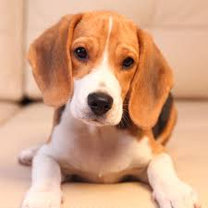
Goal of the project
To apply Deep Learning to be able to detect and identify animal species.
Generate captions for given input.

Slide 3
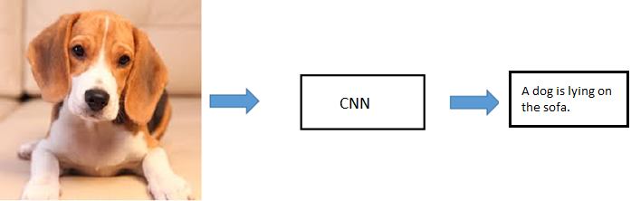
Workflow diagram

Slide 4
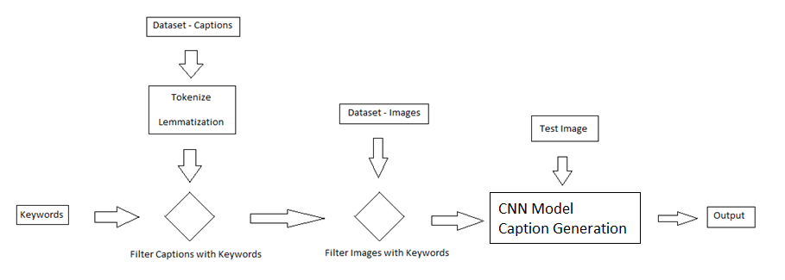
Workflow diagram

Slide 5
Implemented
Dataset: Flickr30k, SBU
Preprocessing of Image Captions Dataset using NLP
Image Classification
Image Caption Generation

Slide 6
Results

Slide 7
Statistics
Dataset | Keywords | Number
SBU | Dog | 234
 | Cat | 283
 | Bird | 248
Flickr30k | Dog | 1793
 | Cat | 46
 | Bird | 68

Slide 8
Statistics
We collected additional images
The total number of images
Keywords | Number
Dog | 12500
Cat | 12500
Bird | 6032

Slide 9
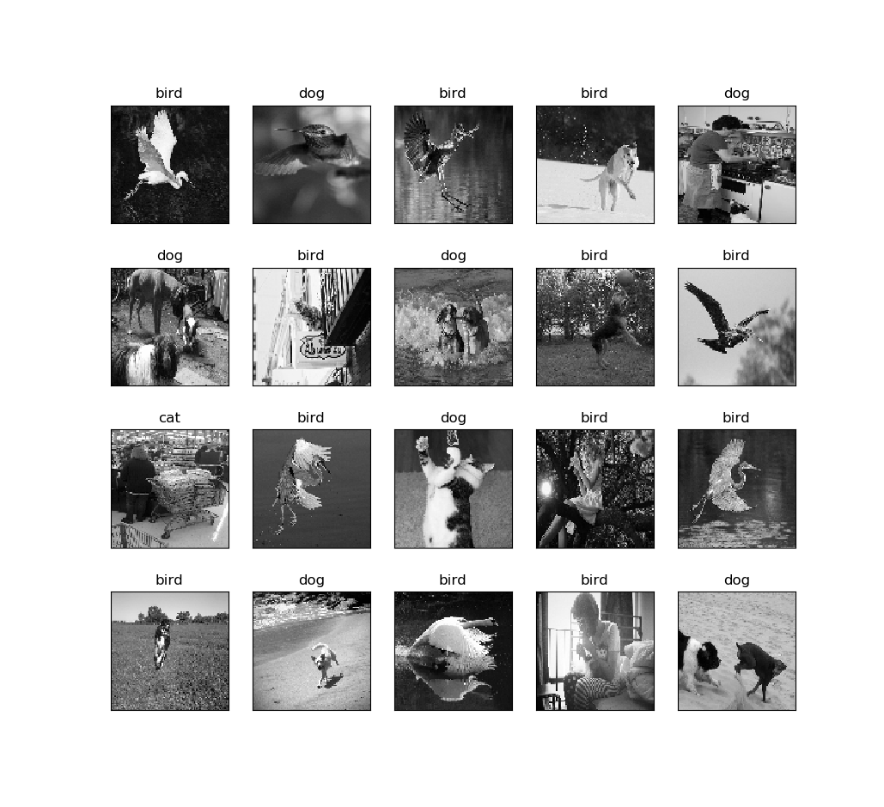
Image Classification
Hyper Parameters used in Classification Models:
Number of Epochs : 5
Learning Rate: 1e-3

Slide 10
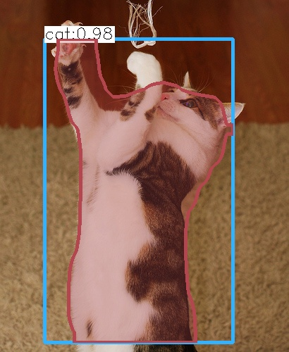
Caption Generation
Captions for image:
a cat laying on top of a wooden table . (p=0.000445)
a cat laying on top of a wooden chair . (p=0.000298)
a cat laying on top of a wooden floor . (p=0.000268)
Image Captioning Scores
BLEU: 0.4825
GLEU: 0.4941

Slide 11
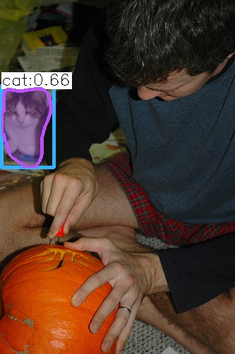
Challenges
Downloading images has taken lot of time
Captions for image:
a man cutting a cake with a knife . (p=0.002712)
a man cutting a cake with a knife . (p=0.002176)
a person cutting a cake with a knife . (p=0.001243)

Slide 12
Thank You

